Slide 1

Data Science applications - Text Classification Assignment
Submitted By :
Group - DSA_202101_ 12
Lasya Bhaskara (300188682)
Tulika Shukla (300201850)
Xun Xun Shi (7260750)

Slide 2

Problem Statement
We are trying to solve a supervised ML problem: to predicts the authorship of the book partitions
Books Chosen -
chesterton-Thursday (1908)
carroll-alice (1800)
shakespeare-hamlet (1609)
bryant-stories (1900-2000)
milton-paradise (1667)
Balanced dataset:
- Take 200 passages with 100 words from each book

Slide 3

The Process
Parameter tuning by grid search with cross-validation
Pre-process to desired text format
Output the Class
Data
Feature Engineering
Model Selection
Evaluate
Scoring
Transfer the text to Numbers
Evaluate the models

Slide 4

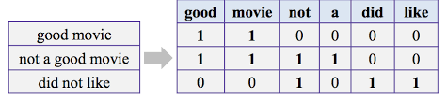
Preprocessing & Feature Engineering
Preprocessing :
Tokenization
Lemmatization
Stopwords
Feature Engineering :
Vectorization is needed to convert our textual data to numerical vectors
We implemented :
Tf-idf
Bag of words (BOW)

Slide 5
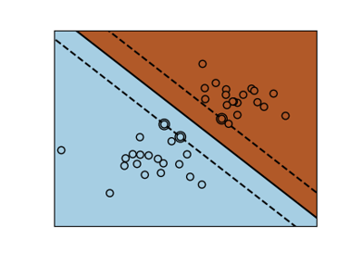
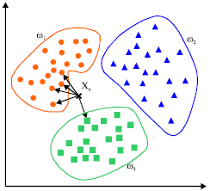
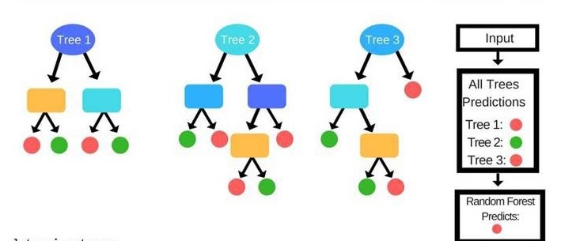
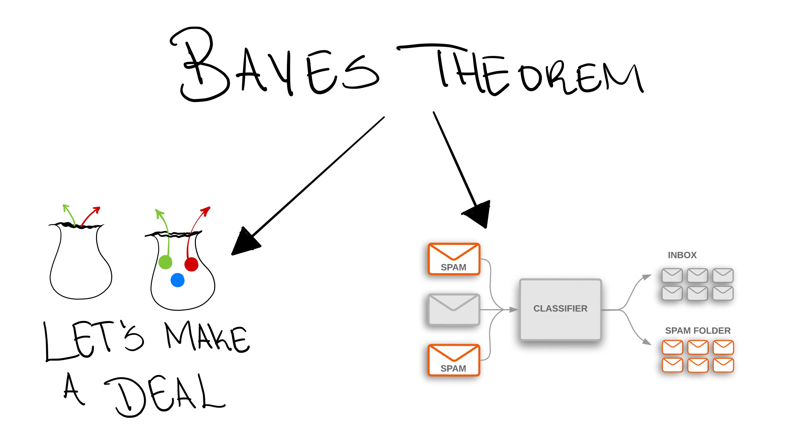
Support Vector Classifier (SVC)
Algorithms Used
Random Forest
Naive Bayes
K Nearest Neighbor
(KNN)
Based on the concept of decision planes that define the decision boundaries
Returns a hyperplane
Feed the features to the classifier to see the predicted class
It builds multiple decision trees and merges them together to get a more accurate and stable prediction
Based on bagging i.e bootstrap aggregation
Prevents overfitting as opposed to single decision tree
Classification techniques based on Bayes’ Theorem
Performs well with multi-class prediction
Classification utilizes distances between features
Distance may be calculated using Manhattan or Euclidean

Slide 6
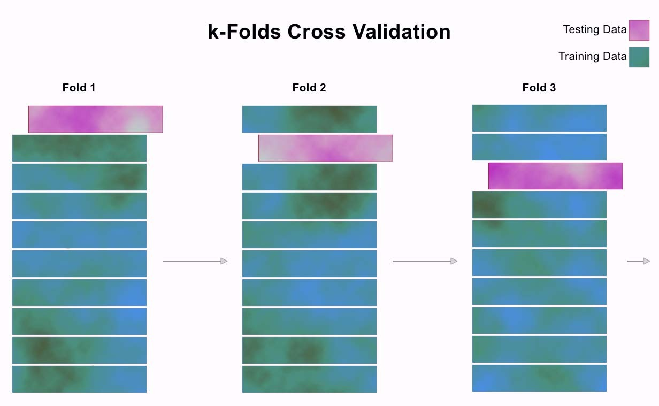
Data Splitting – Train / Test Set
First split the data into two groups :
Testing- holdout on the final optimized model
Training :
Grid Search to identify optimal hyper parameters
10-fold cross validation with each parameter combination
Cross validation – Split train data
9 Parts Train
1 Part Test

Slide 7
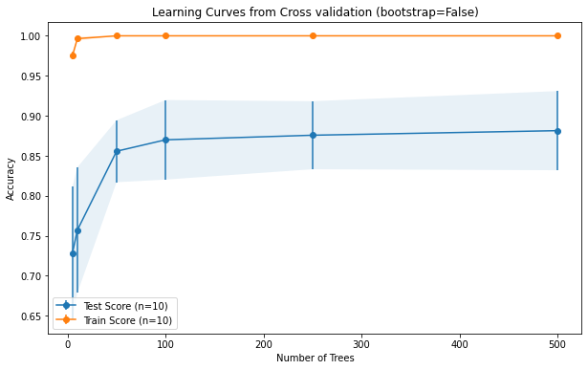
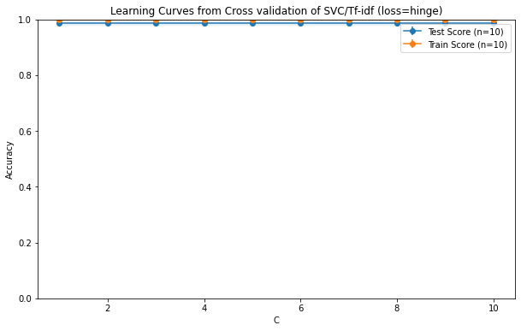
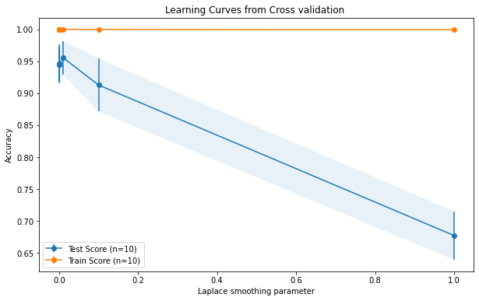
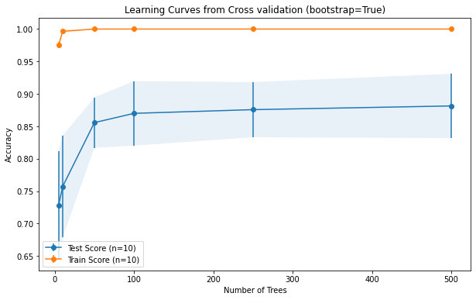
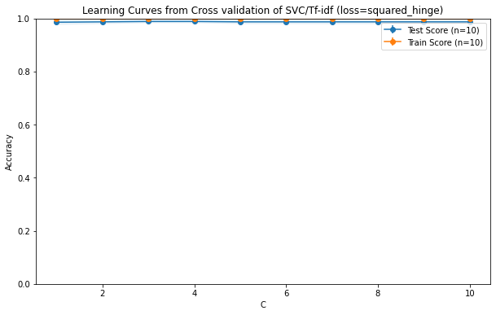
Random Forest | SVC | Naives Bayes
Hyper parameter tuning on: whether to use bootstrap number of trees (5-500) | Hyper parameter tuning on – C type of loss | Performing hyper parameter tuning – laplace_smoothing
Optimal hyper parameters values – Bootstrap – True n_estimators - 500 | Optimal hyper parameters values -C=3 loss = squared hinge | Optimal hyper parameter value – var_smoothing = 0.01
Grid Search for TF-IDF

Slide 8
Optimal hyper parameter on test set
 | Random Forest + TF-IDF | SVC + TF-IDF | NB + TF-IDF | KNN + TF-IDF
Accuracy | 71% | 99% | 94% | 93%
Model
Metric
 | Random Forest + Bow | SVC +BOW | NB + BOW | KNN + -BOW
Accuracy | 96% | 98% | 97% | 93 %
Model
Metric

Slide 9
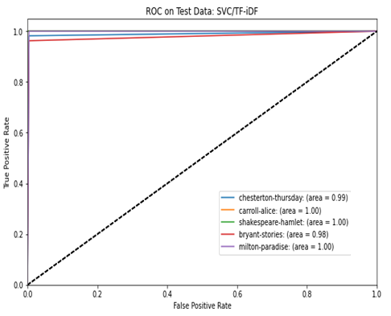
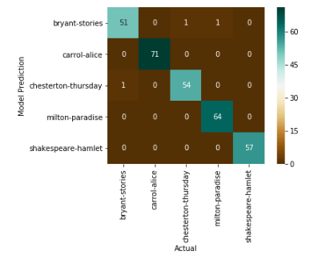
Best Algorithm – SVC – TF-IDF
Confusion Matrix
ROC

Slide 10
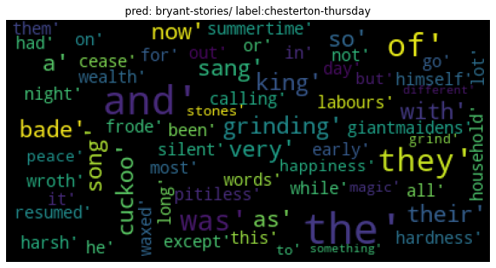
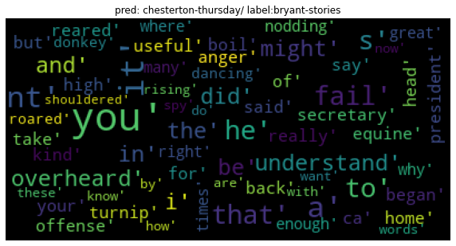
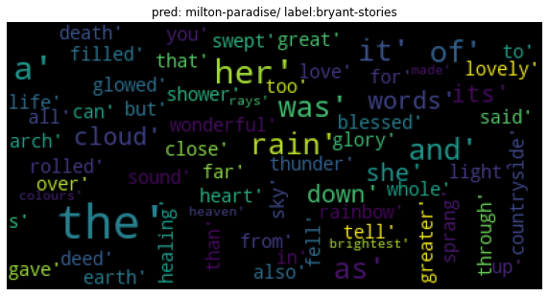
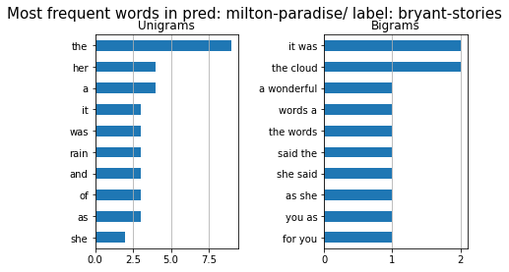
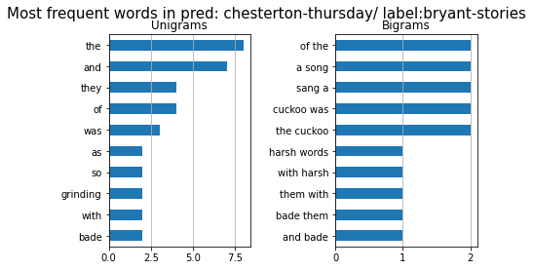
Best Algorithm: Error Analysis
Word Clouds
Unigrams and Bigrams

Slide 11
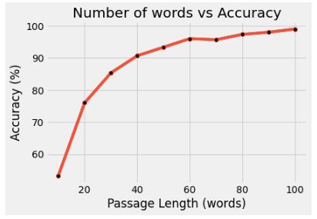
Best Algorithm
Short Passage Analysis
Performed analysis on SVC-tf-idf
Passage length – 10,20,30,…,100
Accuracy decreases with the decrease in the passage length
>90% accuracy for passages of 40 words and up

Slide 12
Conclusion
Tuned and compared 3 different algorithms - 2 feature selections to solve the problem of predicting for authorship.
The optimal combination was SVC with Tf-idf. Prediction accuracy of 99%.
This prediction challenge lies in distinguishing books written in similar time.

Slide 13

Thank you. Questions?

